Slide 1
PERFORMING ADVERSARIAL ATTACK ON VIDEO CLASSIFICATION SYSTEM
GROUP - 02
RICHA THAKUR (D23151)
ASMITA ANKUSH KAMBLE (T23200)
ASHUTOSH SHARMA (B20087)

Slide 2
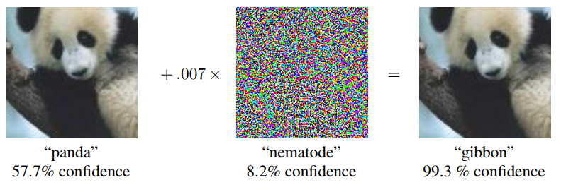
INTRODUCTION
Adversarial Attacks on Image Classification Models
Adversarial attacks are those malicious attacks on the data which may seem okay to the human eye but causes misclassification in a machine-learning pipeline.
An Adversarial Attack is a technique to find a perturbation that changes the prediction of a machine learning model.
Fig. 1: An Adversarial Example Generation [1]
[1] Goodfellow I. J., Shlens J., and Szegedy C. “Explaining and Harnessing Adversarial Examples”, ICLR, 2015.

Slide 3
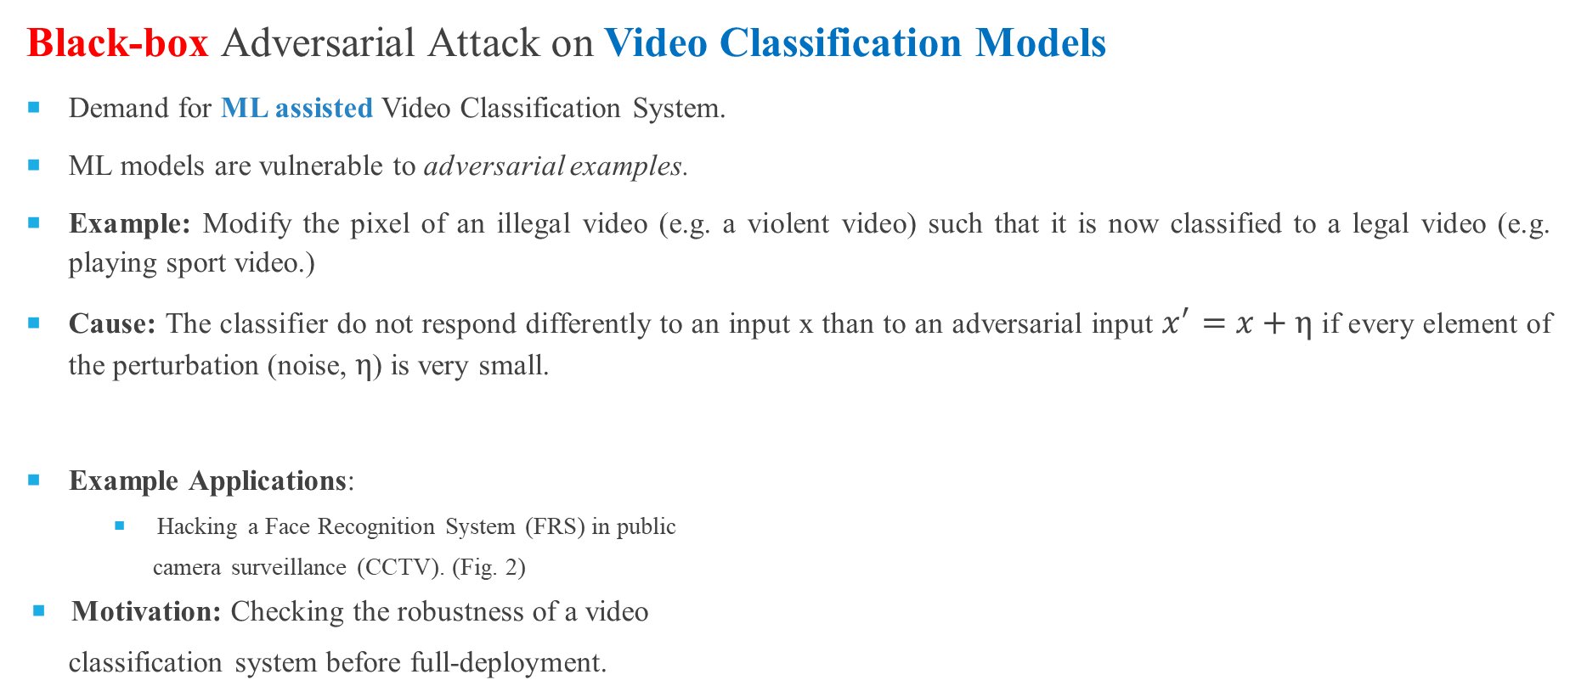

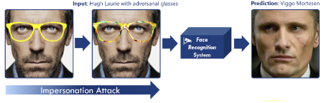
PROBLEM STATEMENT (MOTIVATION)
Fig. 2: Hacking a Face Recognition System (Source: Internet)

Slide 4
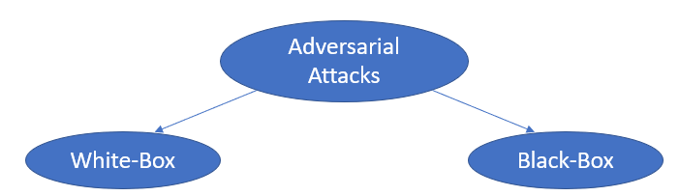
ADVERSARIAL ATTACKS
 | White-Box Attack | Black-Box Attack (more practical)
Adversary Knowledge | Detailed knowledge includes: Network architecture (No. of layers, types of layers) Input, output Training Data Weights, and hyperparameters | No knowledge, except: Querying the model on input, and observing the labels.
Table 1: Adversarial Attack Techniques

Slide 5
LITERATURE REVIEW
Technique | Research Paper | Dataset and Victim Model | Attack target | Published in
Adversarial Attacks | FGSM (Fast Gradient Sign Method) [7] | ImageNet, GoogLeNet (White-box) | Attack on gradients | 2015
 | BIM (Basic Iterative Method) [8] | ImageNet, TensorFlow Camera Flow App (Black-box) | Attack on input images | 2016
 | PGD (Projected Gradient Descent) [9] | CIFAR, DNN hosted by MetaMind, Amazon and Google (Black-box) | Attack on gradients | 2017
 | CW (Carlini and Wagner) [10] | MNIST, Custom CNN (White-box) | Attack on optimization algorithm | 2017
 | AdvGAN (Adversarial GANs) [11] | MNIST, GANs (White-box) | Attack on input images | 2018

Slide 6
LITERATURE REVIEW
Technique | Research Paper | Dataset | Defense Type | Published in
Adversarial Defenses | AdvIT (Adversarial Frames Identifier) [13] | DAVIS2017 | Detection Defense | 2023
 | Comdefend [14] | ILSVRC12 | Reconstruction Defense | 2021
 | Randomized Smoothing (RS) [15] | CIFAR 10 | Certified Defense | 2023
 | CNN-generated Image Detector [16] | CelebDF | Detector for GAN generated image | 2022
 | Adversarial training [17] | CIFAR-10 | Improve accuracy of classifier | 2023

Slide 7
LITERATURE REVIEW (Summary)
Balance: There is no foolproof defense against all possible attacks. Adversarial attacks and defenses are often in a constant parallel race.
Trade-offs: Adversarial defenses often come with trade-offs, such as increased computational cost during training and inference, potential changes in model performance on clean data, and the risk of overfitting to the specific adversarial examples used during training.
Real-world use case: In some cases, the cost and effort required to develop strong adversarial defenses may outweigh the potential risks of attacks. In other cases, security and robustness are critical, and strong defenses are necessary.

Slide 8
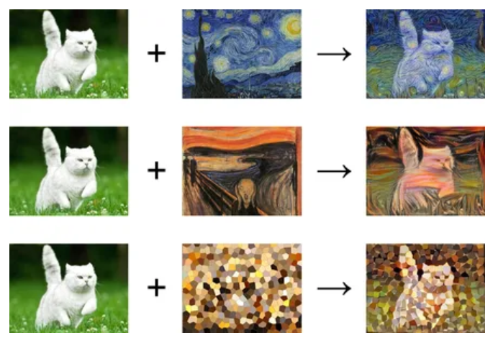
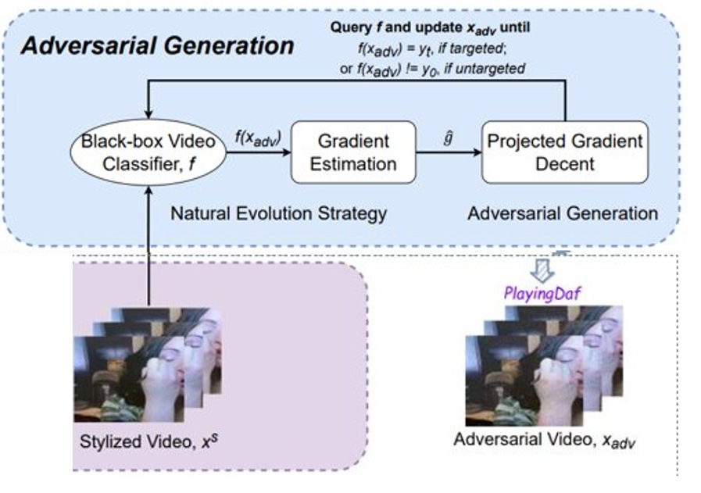


SOTA
StyleFool : A black box unrestricted adversarial attack framework against video classification system. [11]
I.
II.
Original
Style Images
Noise added
(Stylized Images)
III.
[11] Cao, Yuxin, et al. "Stylefool: Fooling video classification systems via style transfer." 2023 IEEE Symposium on Security and Privacy (SP). IEEE, 2023.

Slide 9
REPLICATION OF SOTA
Overview:
Dataset | No. of classes | Total Videos | Classes
UCF-101 Action Recognition Dataset | 101 action classes (175 videos in each class) | 17,675 | 101 actions (125 videos in each class)
Dataset split | Target Video classifier | Accuracy | Attack performance evaluation
70% - Style set 30% - Adversarial sample generation | C3D | 84.9% | 100 randomly selected video
Notes:
101 classes -> 1 class = 1 actin -> 25 x 7 videos hain-> 7 different types, 1 type ki 7 videos hain
C3D learns both spatial and temporal features of input videos using 3D convolution.
C3D requires videos with 16 frames as input, we separate all videos into 16-frame snippets.

Slide 10
REPLICATION OF SOTA (RESULTS)
Untargeted (UCF-101) | ASR | minQ | maxQ | AvgQ
 | 100 | 1 | 19,031 | 3,811
Targeted (UCF-101) | ASR | minQ | maxQ | AvgQ
 | 100 | 1284 | 248,131 | 65,066
Time cost | Preparation/ image (sec) | Attack time cost (min)
 | 0.4174 | 10 - targeted 2 - untargeted
Hardware
RTX3070i
Notes:
101 classes -> 1 class = 1 actin -> 25 x 7 videos hain-> 7 different types, 1 type ki 7 videos hain

Slide 11
LIMITATION OF SOTA - STYLEFOOL
The processes of generating styles, calculating color themes and calculating target class confidence are needed before performing Adversarial attack, which are computationally expensive.
O(class x N x Dim)
Unrestricted perturbation is not always imperceptible to human eyes.

Slide 12
OVERCOMING LIMITATIONS - A NOVEL SOLUTION
Input: Black-box classifier f, input video x₀, input label y₀, target class y_{t}, perturbation threshold ε_{adv}, initial perturbation ε, total loss L_{total}, adversarial loss L, structured noise Ɲ.
Output: Adversarial video x_{adv}.
x_{s} ← (x₀, Ɲ), Generate a sample video by adding a structured noise instead of style set.
if y_{t} == None then,
x_{adv} ← x_{s}
x_{adv} ← PGD(x_{adv}, x_{s}, NES(x_{adv}, L), n, ε_{adv}) , while f(x_{adv}) == y₀
else,
x_{adv} ← x_{s}
x_{adv} ← BPGD(x_{adv}, x_{s}, NES(x_{adv}, L), n, ε_{adv}) , while f(x_{adv}) != y_{t} or ε > ε_{adv}

Slide 13
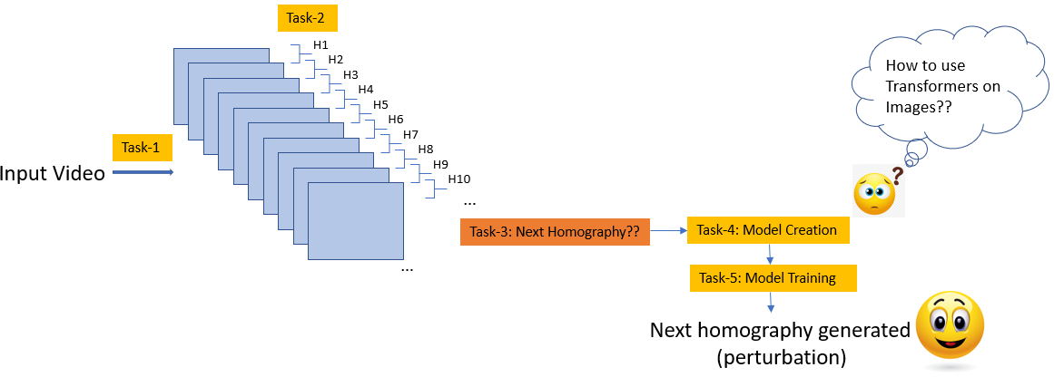
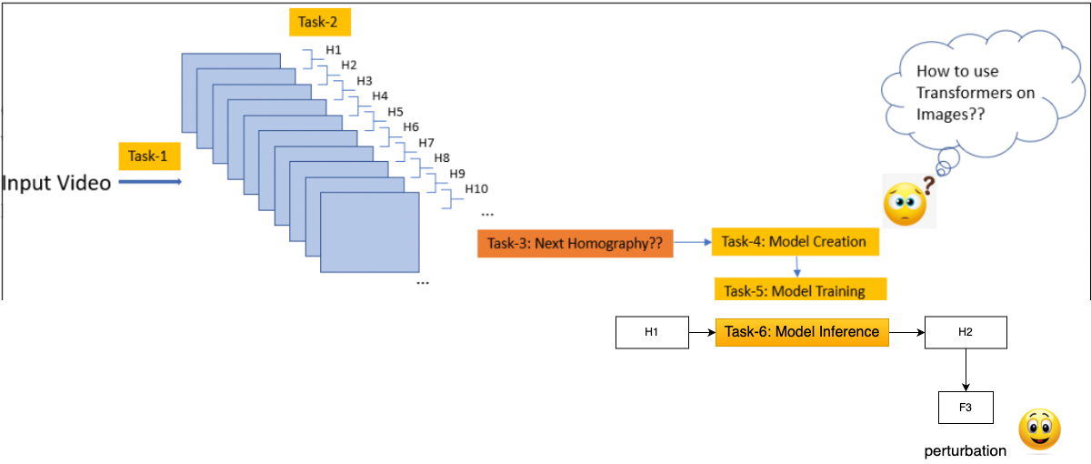
NOVEL IDEA TO IMPLEMENT (METHODOLOGY)
Objective 3: To perform an adversarial black-box attack on Videos using SOTA GPT-2 architecture (presently working on)
Methodology used:
Can we create a structured noise to perform an adversarial black-box attack on Videos classification system?
Fig. : Overview of the methodology being used to generate a structured noise

Slide 14
REFERENCES
[1] Zhang, Yifu, et al. "Bytetrack: Multi-object tracking by associating every detection box." European Conference on Computer Vision. Cham: Springer Nature Switzerland, 2022.
[2] Wang, Chien-Yao, Alexey Bochkovskiy, and Hong-Yuan Mark Liao. "YOLOv7: Trainable bag-of-freebies sets new state-of-the-art for real-time object detectors." Proceedings of the IEEE/CVF Conference on Computer Vision and Pattern Recognition. 2023.
[3] Deng, Jiankang, et al. "Retinaface: Single-stage dense face localisation in the wild." arXiv preprint arXiv:1905.00641 2019.
[4] Liang, Jingyun, et al. "SwinIR: Image restoration using swin transformer." Proceedings of the IEEE/CVF international conference on computer vision. 2021.
[5] Ledig, Christian, et al. "Photo-realistic single image super-resolution using a generative adversarial network." Proceedings of the IEEE conference on computer vision and pattern recognition. 2017.
[6] Deng, Jiankang, et al. "Arcface: Additive angular margin loss for deep face recognition." Proceedings of the IEEE/CVF conference on computer vision and pattern recognition. 2019.
[7] Goodfellow I. J., Shlens J., and Szegedy C. “Explaining and Harnessing Adversarial Examples”, ICLR, 2015.
[8] Kurakin A., Goodfellow I., and Bengio S. “Adversarial Examples in the Physical World”. ICLR 2017.
[9] N. Papernot, P. McDaniel, I. Goodfellow, S. Jha, Z.B. Celik, A. Swami, “Practical black-box attacks against machine learning”, in: Proceedings of the 2017 ACM on Asia conference on computer and communications security, 2017.
[10] Carlini N., Wagner D., “Towards evaluating the robustness of neural networks”, IEEE, 2017.
[11] Xiao, Chaowei, et al. "Generating adversarial examples with adversarial networks." arXiv preprint arXiv:1801.02610 (2018).
[12] Meden, Blaz et al. “Face deidentification with controllable Privacy protection”, Image and Vision Computing, 2023.
[13] Cao, Yuxin, et al. "Stylefool: Fooling video classification systems via style transfer." 2023 IEEE Symposium on Security and Privacy (SP). IEEE, 2023.

